Slide 1
New Orleans Economic Outlook
Janet F. Speyrer, Ph.D.
Associate Dean for Research
College of Business Administration
The University of New Orleans
June 22, 2012

Slide 2
Percent Change in Real U.S. GDP
Source: GSU Economic Forecasting Center

Slide 3
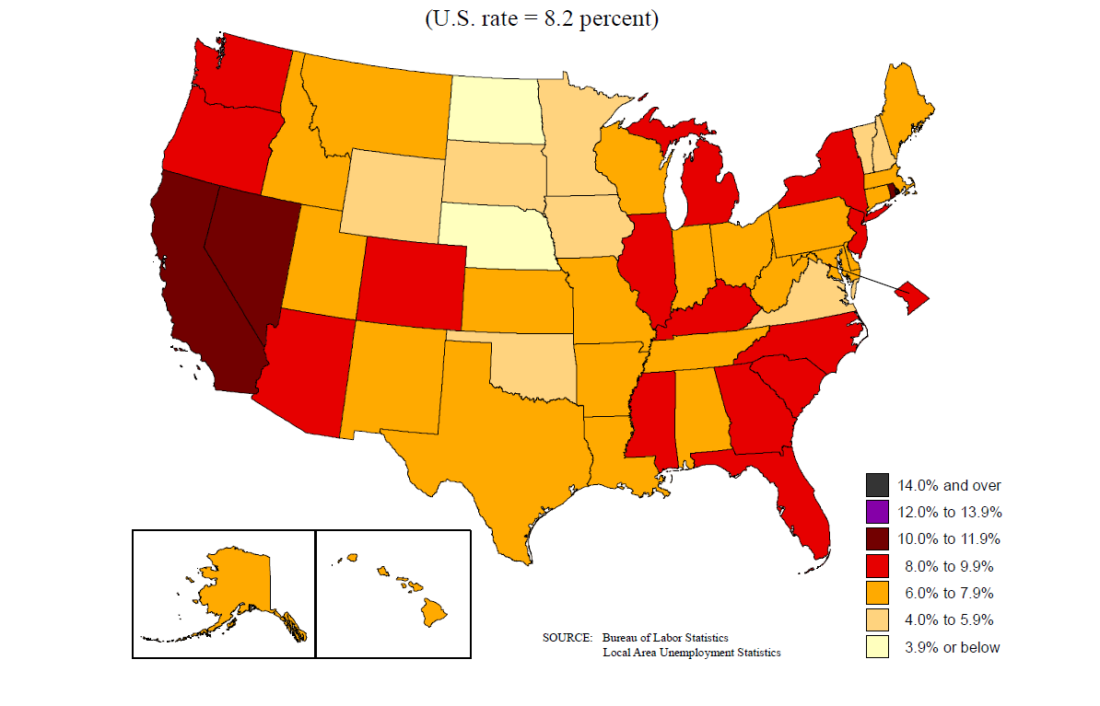
Unemployment Rates by State
May 2012
WA
MT
ND
ME
OR
ID
MN
VT
NH
MA
RI
CT
NJ
DE
MD
DC
SD
WI
NY
WY
MI
NE
IA
PA
NV
UT
IL
IN
OH
CA
CO
KS
MO
WV
VA
KY
TN
NC
AZ
NM
OK
AR
SC
MS
AL
GA
TX
LA
FL
HI
AK

Slide 4
Initial Unemployment Claims New Orleans Metro vs. US (Monthly)
Indexed to 1999 normal levels
Source: US Bureau of Labor Statistics, Louisiana Workforce Commission

Slide 5
Per Capita Personal Income New Orleans Metro vs. US
*Revised to show 2010 Census population figures
Source: Bureau of Economic Analysis, DBER

Slide 6
N. O. Area Average Weekly Wage
Includes 8 parish area: New Orleans Metro plus St. James parish
Source: Louisiana Workforce Commission

Slide 7
Bankruptcies per Capita Eastern District of LA vs. US (Quarterly)
Source: Eastern District Court of Louisiana, American Bankruptcy Institute
*For the 2011 & 2012 per capita figures, the 2010 population estimates were used

Slide 8
Foreclosures per Household New Orleans Metro vs. US

Slide 9
New Orleans Metro Job Overview
The New Orleans metro area had 609,600 jobs in 2005 before Katrina.
At the low point after the storm, the area had just 425,800 jobs (70% of pre-Katrina).
By May 2012, employment in New Orleans had grown to 528,100 jobs (86.6% ).
By the fourth quarter of 2013, 531,000 jobs are forecast (87.1%).

Slide 10
N. O. Metro Total Employment Per Month
Source: US Bureau of Labor Statistics, DBER

Slide 11
New Orleans Jobs by Industry (% pre-Katrina)
Source: US Bureau of Labor Statistics

Slide 12
N. O. Metro Construction Activity Per Month
Source: McGraw Hill Construction, Dodge

Slide 13
New Orleans Metro Total Population
Sources: US Census, GCR & Assoc., System Solutions Consulting

Slide 14
Parish Population
Sources: US Census, DBER estimates, Greater New Orleans Community Data Center

Slide 15
New Orleans Metro Taxable Sales

Slide 16
Total Tonnage Moving Through the Port of New Orleans
Source: Port of New Orleans

Slide 17
Crude Oil and Natural Gas Prices
Source: Georgia State University
Notes:
Note: DOE of energy indicates that Crude Oil (WTI), quarterly, will be between $110 and $115 during the same forecast window

Slide 18
Tourism Indicators Compared to Seasonal Pre-Katrina Levels
Notes:
Note: DOE of energy indicates that Crude Oil (WTI), quarterly, will be between $110 and $115 during the same forecast window

